Slide 1

Implementing Recursion using Stacks: Principles of recursion
Data Structure | ADT: Stack and Queue
Course: Data Structure | Chapter: ADT: Stack and Queue | Program: Bachelor of Engineering
DISCOVER · LEARN · EMPOWER
Notes:
Welcome everyone to today's lecture on Data Structures. We will explore how the Abstract Data Type Stack serves as the fundamental mechanism for implementing recursion. This session bridges the gap between theoretical recursion and its practical execution in memory. Let us begin by understanding the core principles that drive this relationship.

Slide 2
Course Outcomes
SLIDE 2 / 10
Course Outcome
CO | BT LEVEL | DESCRIPTION
CO1 | BT1 | Understand and apply basic data structures, algorithms, complexity analysis, ADTs, arrays and linked lists.
CO2 | BT2 | Apply and implement stacks and queues in problem-solving.
CO3 | BT3 | Analyse and apply searching, sorting, and hashing techniques.
CO4 | BT4 | Construct and apply tree structures and traversal techniques.
CO5 | BT5 | Represent and solve graph problems using DFS, BFS, and graph algorithms.
Chandigarh University
2 / 10
Notes:
Today's lecture directly addresses two specific Course Outcomes. First, we apply our knowledge of ADTs and algorithms to solve complex problems. Second, we see how stack-based recursion is the engine behind graph traversal algorithms like DFS. Mastering this concept is essential for solving real-world computational problems.

Slide 3
Learning Objectives
SLIDE 3 / 10
Learning Outcomes
1
Analyze the structural relationship between the call stack and recursive function execution.
2
Evaluate the necessity of explicit stack management when recursion depth is limited.
3
Construct an iterative algorithm using a stack to replace a recursive solution.
4
Demonstrate the step-by-step state changes of a stack during a factorial calculation.
Chandigarh University
3 / 10
Notes:
By the end of this session, you will be able to analyze how the system stack manages function calls. You will evaluate why explicit stacks are needed for deep recursion. We will construct iterative algorithms to replace recursive ones. Finally, you will demonstrate the state changes during a factorial calculation.

Slide 4
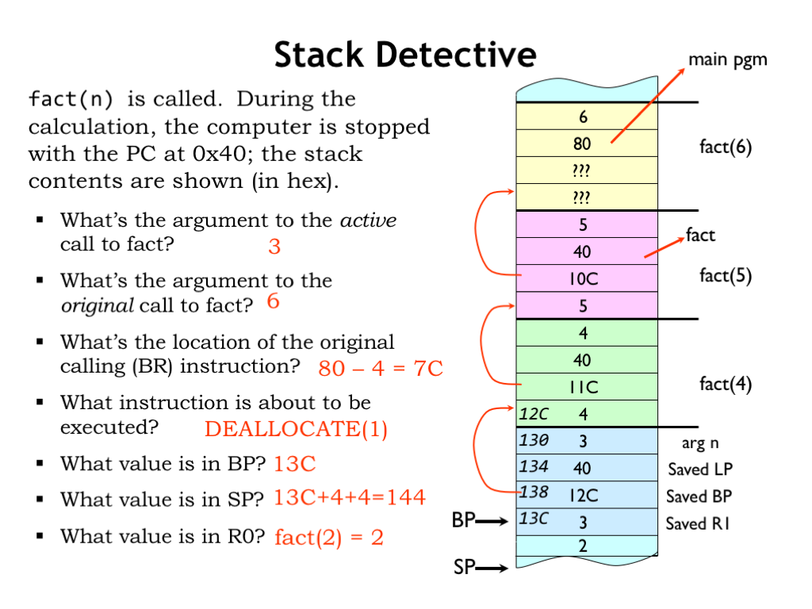
Lecture
SLIDE 4 / 10
The System Stack and Recursion
1
Every recursive function call creates a new activation record on the system stack.
2
The activation record stores local variables, parameters, and the return address for the caller.
3
The stack operates on a Last-In-First-Out (LIFO) principle during function execution.
4
The most recent function call is the first one to complete and return control.
5
Stack overflow occurs if the recursion depth exceeds the allocated memory limit.
L12: Procedures and Stacks
Chandigarh University
4 / 10
Notes:
Think of the system stack as a vertical pile of plates where you only add or remove from the top. When you call a recursive function, the computer pushes a new frame onto this pile. Each frame holds the specific data needed for that specific call. If you recurse too deeply, the pile becomes too tall and crashes the system.

Slide 5
Lecture
SLIDE 5 / 10
Principles of Recursive Execution
1
Recursion requires a base case to terminate the infinite chain of function calls.
2
The base case returns a value without making further recursive calls.
3
The recursive step calls the function with a modified argument closer to the base case.
4
The system stack unwinds only after the base case is reached and returns.
5
Each return value is multiplied by the current level's value during the unwind phase.
Chandigarh University
5 / 10
Notes:
Recursion relies on two critical principles: a base case and a recursive step. Without a base case, the function calls itself forever until the stack overflows. Once the base case is hit, the stack begins to unwind, returning values back up the chain. This process is strictly governed by the LIFO nature of the stack.

Slide 6
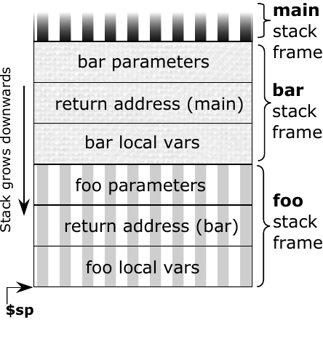
Lecture
SLIDE 6 / 10
Manual Stack Simulation for Factorial
GOVERNING EQUATION
To compute 4!, we push the state (n=4) onto the stack and decrement n
1
We continue pushing states (3, 2, 1) until we reach the base case n=1.
2
The stack now contains [4, 3, 2, 1] with 1 at the top ready to return.
3
We pop 1, multiply by 2, push result 2, then pop 2 and multiply by 3.
4
Finally, we pop 3, multiply by 4, and the final result 24 is returned.
Source: cass-kul.github.io
Chandigarh University
6 / 10
Notes:
Let us trace the calculation of 4 factorial manually. We push 4, then 3, then 2, then 1 onto our stack. Once we hit 1, we start popping. We pop 1, multiply by 2 to get 2. Then we pop 2, multiply by 3 to get 6. Finally, we pop 3, multiply by 4 to get 24. This mimics exactly what the computer does internally.

Slide 7
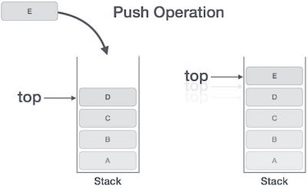
Lecture
SLIDE 7 / 10
Converting Recursion to Iteration
1
An explicit stack data structure replaces the implicit system stack in iterative solutions.
2
The algorithm pushes initial parameters onto the stack before entering the loop.
3
The loop continues as long as the stack is not empty.
4
Inside the loop, we pop the current state and process the result.
5
If a recursive call is needed, we push the new parameters onto the stack.
Source: homework.study.com
Chandigarh University
7 / 10
Notes:
We can convert any recursive algorithm into an iterative one using an explicit stack. Instead of relying on the system's call stack, we manage our own stack data structure. We push the initial state, then loop until the stack is empty. This approach gives us full control over memory usage and prevents stack overflow errors.

Slide 8
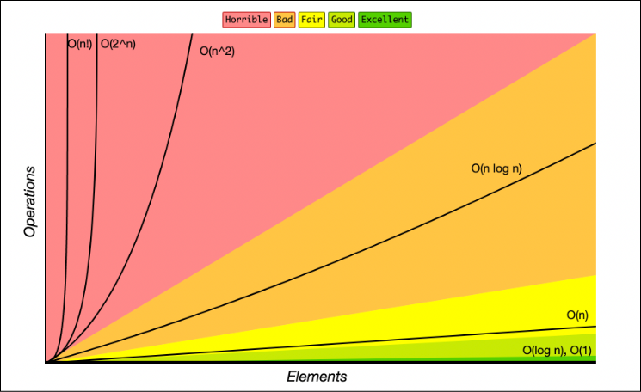
Lecture
SLIDE 8 / 10
Complexity Analysis of Stack Recursion
1
The time complexity of a standard recursive factorial is O(n) for n calls.
2
The space complexity is O(n) due to the n activation records on the stack.
3
Each stack frame consumes memory for local variables and return addresses.
4
Iterative conversion reduces space complexity to O(1) by using a fixed-size stack.
5
Time complexity remains O(n) as the number of operations does not change.
Source: paper-attachments.dropbox.com
Chandigarh University
8 / 10
Notes:
When analyzing complexity, recursion is efficient in time but costly in space. For a factorial of n, we make n calls, so time is O(n). However, we also store n frames on the stack, making space O(n). By converting to an iterative solution with an explicit stack, we can optimize space to O(1) while keeping the same time efficiency.

Slide 9
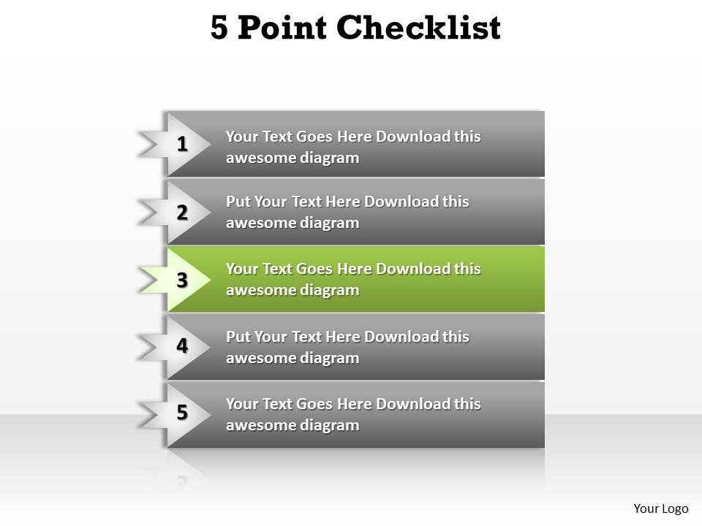
Lecture
SLIDE 9 / 10
Key Takeaways
1
Recursion relies on the LIFO property of the system stack to manage function calls.
2
Every recursive call creates a new activation record containing local variables and return addresses.
3
A base case is mandatory to prevent infinite recursion and stack overflow errors.
4
Explicit stacks allow manual simulation of recursion and enable iterative conversion of algorithms.
5
Iterative solutions using stacks offer better space efficiency compared to deep recursion.
Source: www.slideteam.net
Chandigarh University
9 / 10
Notes:
To summarize, recursion is fundamentally a stack-based process managed by the system. The LIFO principle ensures that the most recent call returns first. Always ensure you have a base case to stop the recursion. You can simulate this manually or convert it to an iterative solution for better space efficiency.

Slide 10
Lecture
SLIDE 10 / 10
References
DATA STRUCTURES
A Pseudocode Approach with C — Gilberg, Forouzan
• Data Structures — Lipschutz
• Data Structure Using C — AK Sharma
• C and Data structure — P. S. Deshpandey
Chandigarh University
10 / 10
Notes:
For further reading, please refer to the standard textbooks listed on this slide. Gilberg and Forouzan provide excellent pseudocode approaches. Lipschutz offers a comprehensive theoretical foundation. Sharma and Deshpandey provide practical C implementations. These resources will help you deepen your understanding of stacks and recursion.

